Slide 1
SVSU Training for Title IX Advisors
Rebecca Joseph

Slide 2
Agenda
10,000 Foot View: Title IX Overview
The Live Hearing: Understanding Format and Advisor Expectations
Cross-Examination: Tips & Tricks
Anticipating Relevancy Determinations: Crafting Helpful and Relevant Questions
Advocating for your Party: Best Practices

Slide 3
Disclaimers
Not providing legal advice today.
You can ask hypothetical questions today, but please refrain from disclosing case-specific details.
Refer to the Policy or check with Dr. Thorns if you have questions about the grievance process or your role as an advisor.

Slide 4
Title IX Overview

Slide 5
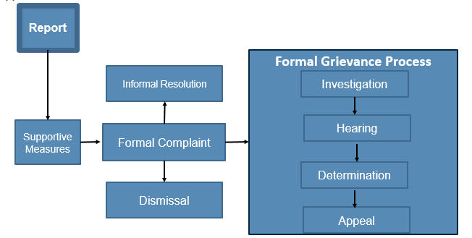
Title IX Foundations
Advisor MAY be included
Advisor MAY be included
Advisor MUST be included
Advisor role not applicable
Advisor MAY be included

Slide 6
Title IX Foundations (2)
Respondent is presumed not responsible for a violation
The decision as to whether a Respondent is responsible for a violation will be based on a preponderance of the evidence
Both parties have access to supportive measures
Retaliation is prohibited

Slide 7
Understanding the Roles of Title IX Officials
Title IX Coordinator
Investigator
Decision Maker

Slide 8
Title IX Coordinator
Oversees procedural integrity
Oversees the whole process and helps to ensure the written process and the as applied process are the same
Often is the person who ensures the investigators, decision-makers, informal resolution officers and appeals officers are properly trained
Often is the person who ensures advisors are available for hearings
Makes decisions on new issues that arise to keep them in compliance with the policy

Slide 9
Title IX Coordinator (2)
For advisor purposes, must understand the that the Title IX Coordinator:
  Often is the person who selects and assigns a specific investigator, decision-maker, and appeals officer to a matter
  May be the person who supervises the Title IX Office
  May be the investigator

Slide 10
The Investigator’s Roles
The Gatherer & Organizer of all relevant evidence.
  Does not make a determination on the facts
  Determines some level of whether evidence is relevant.

Slide 11

The Decision-Maker’s Role
Make relevancy determinations…before any question at the live cross-examination hearing can be answered
Run an orderly and truth-seeking live cross-examination hearing
Write a decision: apply the policy, use standard of review, and evaluate relevant evidence still in the record after the hearing

Slide 12

The Decision-Maker’s Role & The Advisor
The advisor will interact most with the decision-maker during the grievance process.
The live cross-examination hearing is where the advisor has the most active role.
ADVISOR

Slide 13
What You May Receive Before the Hearing
Investigative Report
  Contains:
    Summary of alleged conduct in violation of the Policy, including a description of the impact or effect alleged to have been caused
    A summary of the response to the allegations
    A summary of facts found during the investigation
    Analysis of the application of this Policy to facts found in the Investigation
  Does not contain:
    Findings of fact or conclusions
Relevant evidence relating to the case
Responses of the parties to the evidence and the report (if they submitted responses)
Contact information for your party (complainant or respondent)
Applicable policy language
Other relevant communications about the hearing

Slide 14
Understanding the Bases for Appeal
As an advisor, these can inform your approach at the hearing – especially regarding relevancy determinations that you disagree with as the advisor.
Whether you are involved at the appeal level or not (again, regulations only require appointed advisor during the hearing process) - will need to think about how to set up those relevancy challenges for appeal while in the hearing
Three basis:
  Procedural irregularity
  New evidence
  Bias/Conflict of Interest
The appealing party must establish why the procedural irregularity, new evidence, or bias/conflict of interest impacted or would impact the outcome of the original determination.

Slide 15
The Hearing

Slide 16
The Setup
Can conduct the hearing with all parties and advisors in one shared room, unless a party requests separate rooms and recipient chooses to do so.
Most common set up: Separate rooms with technology allowing live cross examination at the request of either party (ex: Zoom)
  “At recipient’s discretion, can allow any or all participants to participate in the live hearing virtually” (30332, see also 30333, 30346) explaining 106.45(b)(6)(i)

Slide 17
SVSU Process
Cross-examination must to be done by the party’s “advisor of choice and never by a party personally.”
  An advisor of choice may be an attorney or a parent (or witness) (30319)
  Discretion to require advisors to be “potted plants” outside of their roles cross-examining parties and witnesses. (30312)
Discretion for parties to provide opportunity for opening or closing statements (advisor can help prepare)
Discretion to conduct direct questioning (open-ended, non-cross questions of a party by their own advisor)

Slide 18
Advisors (1 of 3)
If a party does not have an advisor present at the live hearing, the recipient must provide without fee or charge to that party, an advisor of the recipient’s choice, who may be, but is not required to be, an attorney, to conduct cross-examination on behalf of that party. 106.45(b)(6)(i) and Preamble 30339.

Slide 19
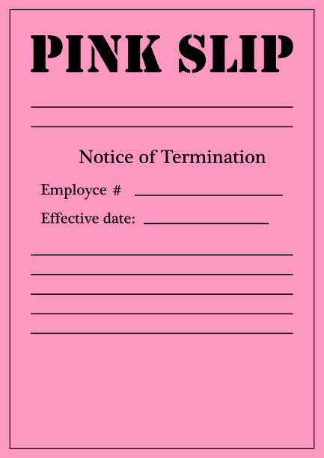
Advisors (2)
Advisors do not require Title IX Training, however a recipient may train its own employees whom the recipient chooses to appoint as party advisors (30342)
A party cannot “fire” an appointed advisor (30342)
“But, if the party correctly asserts that the assigned advisor is refusing to ‘conduct cross-examination on the party’s behalf’ then the recipient is obligated to provide the party an advisor to perform that function, whether counseling the advisor to perform the role or stopping the hearing to assign a different advisor” (30342)

Slide 20

Decorum (1)
The preamble contains many discussions of an institution’s discretion to set rules to maintain decorum throughout hearings and to remove non-complying advisors, parties, or witnesses.
Note: In our experience, we have seen decorum issues more commonly with advisors than parties…and have seen this equally on both sides.

Slide 21
Decorum (2)
“[T]he essential function of cross-examination is not to embarrass, blame, humiliate, or emotionally berate a party, but rather to ask questions that probe a party’s narrative in order to give the decision-maker the fullest view possible of the evidence relevant to the allegations at issue.” (30319)
Nothing in this rule prevents recipient from enforcing decorum rules in the hearing and “the recipient may require the party to use a different advisor” if the advisor does not comply and may provide a different advisor to conduct cross examination on behalf of that party. (30320)

Slide 22
Decorum (3)
“The Department acknowledges that predictions of harsh, aggressive, victim-blaming cross-examination may dissuade complainants from pursuing a formal complaint out of fear of undergoing questioning that could be perceived as interrogation. However, recipients retain discretion under the final regulations to educate a recipient’s community about what cross-examination during a Title IX grievance process will look like, including developing rules and practices (that apply equally to both parties) to oversee cross-examination to ensure that questioning is relevant, respectful, and non-abusive.” (30316 see also 30315; 30340)

Slide 23
Cross-Examination

Slide 24
Cross Tools: What are the goals of cross-examination?
Obtain factual admissions helpful to your party’s case.
Corroborate the testimony of your party’s witnesses.
Minimize the other party’s case by impeachment of witness being questioned.
Minimize the other party’s case by impeachment of other witnesses through the witnesses being questioned.
Reduce confusion and seek truth.

Slide 25

Live Cross-Examination: Theory
Essential for truth seeking (30313)
Provides opportunity of both parties to test “consistency, accuracy, memory, and credibility so that the decision-maker can better assess whether a [party’s] narrative should be believed” (30315)
Provides parties with the opportunity to “direct the decision-maker’s attention to implausibility, inconsistency, unreliability, ulterior motives, and lack of credibility” in the other party’s statements. (30330)
Promotes transparency and equal access (30389)

Slide 26
Cross Examination
Traditionally, cross examination questions are those that try to elicit “yes” or “no” answers, not explanations.
Examples:
You were at the party that night, weren’t you?
You’d agree with me that you had three beers, wouldn’t you?
You didn’t call an Uber, did you?

Slide 27
Live Cross-Examination In Practice (1)
In this process:
  Decision-maker must permit each party’s advisor to ask the other party and any witnesses all relevant questions and follow-up questions, including those challenging credibility
  Must be conducted directly, orally, and in real time by the party’s advisor, but never party personally
  Only relevant cross-examination and other questions may be asked of a party or witness
“[C]onducting cross-examination consists simply of posing questions intended to advance the asking party’s perspective with respect to the specific allegation at issue.” (30319)

Slide 28
Live Cross-Examination In Practice (2)
In this process:
  Decision-maker must permit each party’s advisor to ask the other party and any witnesses all relevant questions and follow-up questions, including those challenging credibility
  Must be conducted directly, orally, and in real time by the party’s advisor, but never party personally
  Only relevant cross-examination and other questions may be asked of a party or witness
  Before a party or witness may answer a question, the decision-maker must first determine whether the question is relevant and explain the reason if not relevant
  Must audio record, audio-video record or provide a transcript of the hearing

Slide 29
Relevancy Determinations

Slide 30
Questioning by the Decision-Maker (1)
The neutrality of the decision-maker role is and the role of the advisor to ask adversarial questions, protects the decision-maker from having to be neutral while also taking on an adversarial role (30330)
“[P]recisely because the recipient must provide a neutral, impartial decision-maker, the function of adversarial questioning must be undertaken by persons who owe no duty of impartiality to the parties” (30330)

Slide 31
Questioning by the Decision-Maker (2)
BUT “the decision-maker has the right and responsibility to ask questions and elicit information from parties and witnesses on the decision-makers own initiative to aid the decision-maker in obtaining relevant evidence both inculpatory and exculpatory, and the parties also have equal rights to present evidence in front of the decision-maker so the decision-maker has the benefit of perceiving each party’s unique perspective about the evidence.” (30331)

Slide 32
Relevancy (1)
“[C]ross examination must focus only on questions that are relevant to the allegations in dispute.” (30319)
“Only relevant cross-examination and other questions may be asked of a party or witness.”

Slide 33

Relevancy (2)
Party or witness cannot answer a question until the decision-maker determines whether it is relevant.
    Requires decision-makers to make “on the spot” determinations and explain the “why” if a question or evidence is not relevant (30343)
[Question]
“Relevant”
Advisor
[Answer]
Decision
Maker
Party

Slide 34
What is Relevant?
The regulations don’t really tell us directly.
Relevant evidence may include:
  Evidence that is “probative of any material fact concerning the allegations.” (30343)
  Evidence pertinent to proving whether facts material to the allegations under investigation are more or less likely to be true (i.e., on what is relevant)
A recipient may not adopt rules excluding certain types of relevant evidence (lie detector or rape kits) where that type of evidence is not labeled irrelevant in the regulations (e.g., sexual history) or otherwise barred for use under 106.56 (privileged) and must allow fact and expert witnesses. (30294)

Slide 35
This means the Hearing Officer…
Cannot exclude redundant evidence
Cannot exclude character evidence
Cannot exclude hearsay
Cannot exclude evidence where the probative value is substantially outweighed by the danger of unfair prejudice (30294)

Slide 36
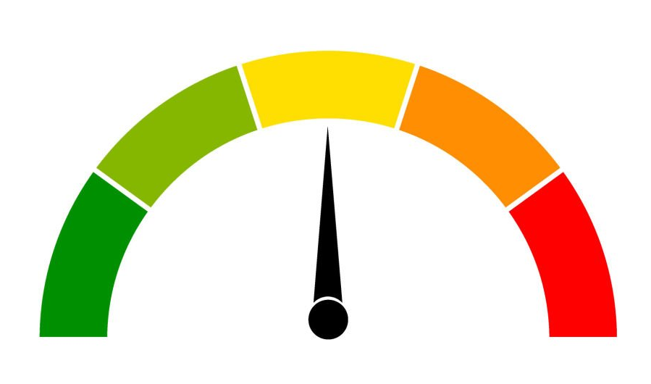
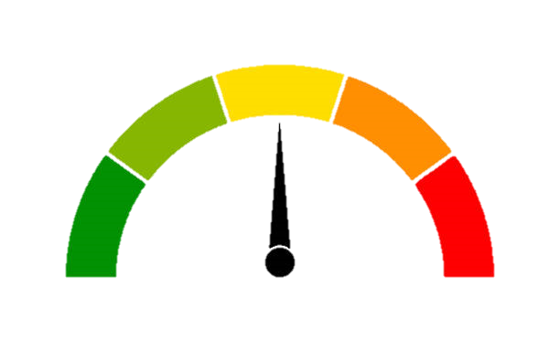
What is Relevant? (2)
Does this question, topic, evidence help move the dial under the standard of evidence?
FACT: _______________________
Preponderance of the evidence:
A fact is more likely than not to be true
(30373 fn. 1409)
LESS LIKELY
MORE LIKELY

Slide 37



What is Not Relevant?
The Department of Education has determined that recipients must consider all relevant evidence with the following exceptions:
Party’s medical/treatment records
(unless voluntary written consent)
Information protected by a legally recognized privilege
Complainant’s sexual behavior
(except for two exceptions)

Slide 38
Treatment Records
“[C]annot access, consider, disclose, or otherwise use a party’s records that are made or maintained by a physician, psychiatrist, psychologist, or other recognized professional or paraprofessional acting in the professional’s or paraprofessional’s capacity, or assisting in that capacity, and which are made and maintained in connection with the provision of treatment to the party, unless the recipient obtains that party’s voluntary, written consent to do so for a grievance process under this section.”
Section 106.45(b)(5)(i) (see also 30317).

Slide 39
Legally Privileged Information
Preamble identifies medical and treatment records.
Other typical privileges recognized across jurisdictions but with variations (will want to involve your legal counsel for definitions in your jurisdiction):
Attorney-client communications
Implicating oneself in a crime
Confessions to a clergy member or other religious figures
Spousal testimony in criminal matters
Some confidentiality/trade secrets

Slide 40
Rape Shield Provision & Complainant
Must exclude evidence about complainant’s prior sexual history unless such questions/ evidence:
  Are offered to prove that someone other than the respondent committed the conduct; or
  If the questions/evidence concern specific incidents of the complainant's prior sexual behavior with respect to the respondent and are offered to prove consent.

Slide 41
Relevancy: Rape Shield Provision & Respondent
Rape shield protections do not apply to Respondents
“The Department reiterates that the rape shield language . . . does not pertain to the sexual predisposition or sexual behavior of respondents, so evidence of a pattern of inappropriate behavior by an alleged harasser must be judged for relevance as any other evidence must be.”
Guidance from Sept. 2021 Q&A: no parties sexual history is usually relevant

Slide 42
Rape Shield Provision Flowchart
There is a question or evidence about sexual history. What do you do next?
Is the evidence about COMPLAINANT’S prior sexual history?
Yes
No
No
Is it offered to:
(1) prove that someone other than the respondent committed the conduct
OR
(2) Prove consent about specific incidents of the complainant’s prior sexual behavior with respect to the respondent
Yes
Potentially relevant, must be judged for relevance as any other evidence must be
NOT Relevant
Potentially relevant, must be judged for relevance as any other evidence must be

Slide 43
Relevancy: Improper Inference (1)
“If a party or witness does not submit to cross-examination at the live hearing…the decision-maker(s) cannot draw an inference about the determination regarding responsibility based solely on a party’s or witness’s absence from the live hearing or refusal to answer cross-examination or other questions.” 34 C.F.R. 106.45(b)(6)(i).
When parties elect not to participate, a recipient cannot retaliate against them (30322)
The preamble recognizes that there are many reasons a party or witness may not elect not to participate in the live cross-examination hearing or answer a question or set of questions
Bottom Line: The decision-maker cannot make inferences from non-participation or compel participation (retaliation) (30322)

Slide 44
Relevancy: Improper Inference (2)
“[A] party’s advisor may appear and conduct cross-examination even when the party whom they are advising does not appear.” (30346)
“Similarly, where one party does not appear and that party’s advisor does not appear, a recipient-provided advisor must still cross-examine the other, appearing party, resulting in consideration of the appearing party’s statements (without any inference being drawn based on the non-appearance).” (30346)

Slide 45
Advocating for Your Party

Slide 46
Hearing Preparation (1)
Review the entire investigation hearing report
Review all evidence (some may have non-relevant evidence also—know if you disagree with any relevancy determinations made by the investigator)
Meet with your party to review what your party thinks and wants
Discuss strategy for cross-examination

Slide 47
Hearing Preparation (2)
Realize that your party may want to take a more aggressive approach – If you are not comfortable with the approach, discuss it with the party and check to see if you can advise your party
Discuss the expectations of decorum vs. the expectations of questioning the other party and witness

Slide 48
Hearing Preparation (3)
Determine who your witnesses are and whether your party thinks they will show up to the hearing
Be careful of the line between asking a party to participate and explain the importance of their statements vs. coercing a party to participate who has the right not to participate

Slide 49
Hearing Preparation (4)
Consider preparing a script for your questions:
  List each allegation and policy definition/elements for the policy violation (e.g., sexual assault—know which definition and what must be met to show sexual assault under the policy)
  List your questions you plan to ask for your party for each other party and witness AND be prepared to answer why each is relevant
  Have a list of relevancy definitions to refer to if they come up
    Rape shield law and two exceptions
    Privileged information in your jurisdiction
    Language on treatment records

Slide 50
During the Hearing
Ask one question at a time and wait for the Decision-Maker to determine if it is relevant
If the Decision-Maker has a question about why the question is relevant, be prepared to answer that question
Be respectful of the process so that you can effectively ask your party’s questions – if you think you or someone else is becoming too heated, ask for a break to regroup
Be aware that the other advisor may not be as prepared as you are and the decision-maker has a duty to ask questions the advisor does not—this doesn’t mean the decision-maker is biased or trying to help the other side – you may not like it, but it’s a requirement for the decision-maker

Slide 51
After the Hearing
The decision-maker will issue a decision to both parties at the same time.
Under the regulations, the advisor is not required to have any further role in the process (this may be especially true if the advisor is appointed by the institution)
Other advisors (attorney or parent), may choose to work with the party to appeal on the bases listed in the decision

Slide 52
Confidentiality
106.71 requires recipients to keep party and witness identities confidential except as permitted by law or FERPA, and as needed to conduct an investigation or hearing (30316)
Prevents anyone in addition to the advisor to attend the hearing with the party, unless otherwise required by law (30339)

Slide 53
Conflict of Interest & Prohibition on Retaliation (1)
Remember that parties are permitted to select their advisor of choice, but choice does not eliminate institutional risk
Consider:
  Do you have a supervisory or disciplinary relationship with any party or witness?
  Do you have the ability to influence employment, academics, funding, or opportunities for a party or witness in this case?
  Could your involvement be perceived as pressuring participation or testimony?
  Could a party or witness feel unable to decline participation or answer questions freely because of your role?
  Are you in a position where your actions could be interpreted as rewarding or penalizing someone based on their involvement in this matter?

Slide 54
Conflict of Interest & Prohibition on Retaliation (2)
Title IX prohibits retaliation and interference with participation.
Even appearance of retaliation or coercion can undermine the process.
Power dynamics may affect whether participation is truly voluntary.
These concerns can impact: credibility of the process, willingness of witnesses to participate, and could create potential appeal issues (bias/conflict)

Slide 55
Conflict of Interest & Prohibition on Retaliation (3)
Best practices:
  Let the Title IX Coordinator know – Disclose any supervisory or authority relationship early.
  Consider whether you should decline or withdraw as an advisor.
  Avoid discussing the case in your supervisory role.
  Do not take any action that could be perceived as:
    Influencing testimony
    Discouraging participation
    Punishing involvement
    Implementing sanctions prior to a finding of responsibility

Slide 56
Thank you for attending

